Slide 1
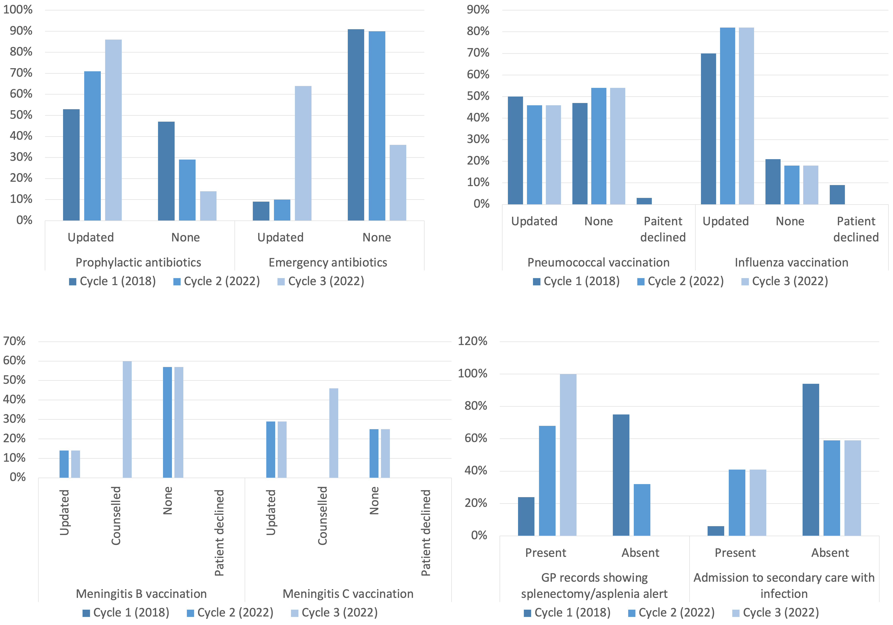
Post-splenectomy patients: a reaudit of current practice
Gargi Samarth, Laura Pigott, Megan Lloyd, Martin Hughes, Pritti Aggarwal, Alexandra Freeman, Paula Hunt
Living Well Partnership
Introduction
Methods
Splenectomies involve removal of the spleen, which is indicated in trauma, haematological malignancies, splenomegaly and haematological diseases (sickle cell disease or thalassemia). The spleen is involved in the adaptive immune response, and responsible for storage of white blood cells, synthesis of antibodies, thus removal leads to a compromised immune response in particular to encapsulated organisms, and a high risk of opportunistic infections. We conducted 3 PDSA cycle audit between 2018 and 2022 to assess compliance to the British Committee for Standards in Haematology (BCSH) guidelines for post-splenectomy and asplenic patients.
37860 registered patients
N = 29 patients with asplenia or splenectomy
N = 28 patients with asplenia or splenectomy
1 excluded (out of area)
Audit Interventions
PDSA 1 (2018)
PDSA 2 (2022)
PDSA 3 (2022)
Results
Splenectomy alert on EMIS
Patient information leaflet
Coding of splenectomy/asplenia following discharge
Influenza and pneumococcal vaccination calendar alerts
Splenectomy alert on EMIS
15 minute telephone consultation
Coding of splenectomy/asplenia following discharge
Influenza and pneumococcal vaccination calendar alerts
Conclusion
This study found that a patient-centred intervention can improve compliance with established immunisation guidelines and antibiotic prophylaxis for post-splenectomy patients in primary care. This intervention should be considered for implementation in other primary care settings.
References
British Committee for Standards in Haematology. Guidelines for the prevention and management of overwhelming post-splenectomy infection (OPSI). Br J Haematol. 2011;155(5):654-66.
Ramachandra P, Hegde S, Pai P, et al. Post-splenectomy care in primary care: a retrospective study. J Prim Care Health Promot. 2018;8(1):13.
O'Donoghue E, Kelly S, O'Connor P, et al. Post-splenectomy care in primary care: a patient survey. Br J Haematol. 2014;167(4):592-6.

